Slide 1
Adding Pictures and Shapes to a Worksheet
Microsoft Excel 2013
Lesson 13

Slide 2
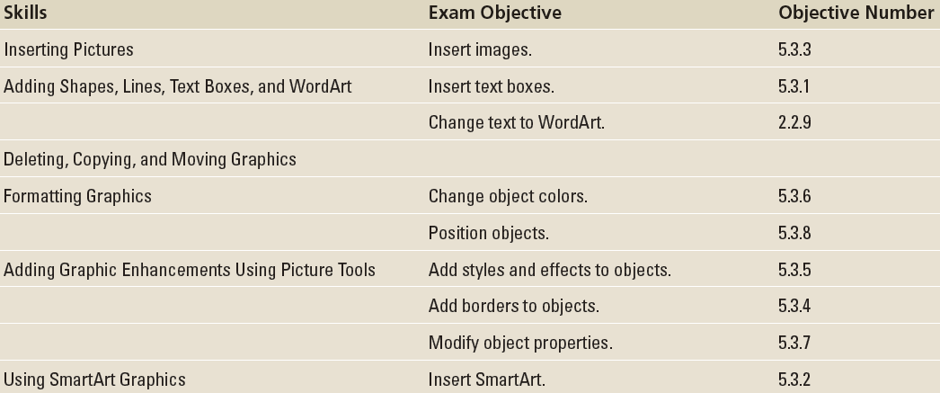
Objectives

Slide 3
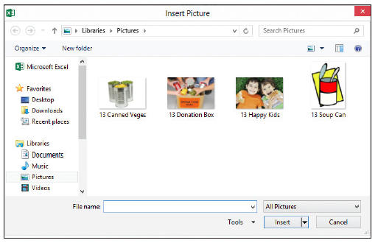
Step by Step: Insert a Picture from a File
GET READY. LAUNCH Excel and open a new, blank workbook. Download the image files for this lesson and SAVE them in the My Pictures folder. Alternatively, you can create a subfolder in your student data folder named Lesson 13 Images and save the images in that subfolder.
On the INSERT tab, in the Illustrations group, click the Pictures button. The Insert Picture dialog box opens (right).

Slide 4
Step by Step: Insert a Picture from a File
Navigate to the folder that holds the image files for this lesson. Double-click the 13 Happy Kids image, or click it once and then click the Insert button. The picture is inserted into your worksheet.
SAVE the workbook as 13 Insert Pictures.
PAUSE. Leave the workbook open to use in the next exercise.
Notes:
Troubleshooting: If you don’t see your picture file listed in the Insert Picture dialog box after navigating to the folder where the picture is stored, click the All Pictures drop-down list to the right of the File Name box. Excel will display all pictures that it supports, such as BMP, JPG, PNG, TIFF, and more.

Slide 5
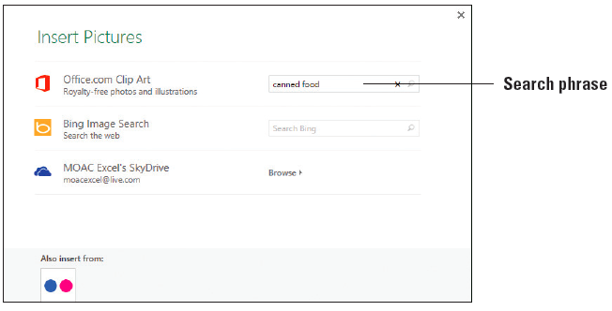
Step by Step: Insert Office.com Clip Art
GET READY. USE the workbook from the previous exercise.
Click in cell J1.
On the INSERT tab, in the Illustrations group, click the Online Pictures button. The Insert Pictures dialog box appears.
To the right of Office.com Clip Art, click in the Search box. Type a keyword or phrase, such as canned food (above).

Slide 6
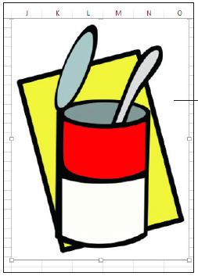
Step by Step: Insert Office.com Clip Art
Click the magnifying glass icon at the right end of the search box or press Enter to begin the search. Excel searches the online Office clip art database for images containing the keywords “canned food” in their metadata.
The dialog box displays the images that meet the search criteria. To insert one of the images, click on it and then click the Insert button in the dialog box. You can also double-click the desired image to insert it into your worksheet. When an image is inserted, the dialog box closes automatically. The figure at right shows a clip art image inserted into the worksheet.

Slide 7
Step by Step: Insert Office.com Clip Art
SAVE the workbook.
PAUSE. Leave the workbook open to use in the next exercise.

Slide 8
Step by Step: Insert an Image via a Bing Image Search
GET READY. USE the workbook from the previous exercise.
On the INSERT tab, in the Illustrations group, click the Online Pictures button. The Insert Pictures dialog box appears.
Click in the Search Bing box to the right of Bing Image Search.
Type a keyword or phrase, such as children eating lunch, to search the Internet via the Bing web browser for images containing those keywords in their metadata.
Click the magnifying glass icon at the right end of the search box or press Enter to begin the search.

Slide 9
Step by Step: Insert an Image via a Bing Image Search
The dialog box displays the images that meet the search criteria. To insert one of the images, click on it and click the Insert button in the dialog box. You can also double-click the desired image. Once an image is inserted, the dialog box closes automatically. Notice that the image was inserted over the top of the clip art image.
Click the newly inserted image to select it, and then press the Delete key on your keyboard.
PAUSE. Leave the workbook open to use in the next exercise.
Notes:
Take Note: Most images you find on the Internet are copyrighted, even if you don’t see a copyright symbol or copyright text associated with the image. If you intend to use an image you find on the Internet, you need to contact the image owner and seek permission. As an alternative, you can search for “public domain images” to find images that are not restricted by copyright, or purchase images from any number of stock image websites.

Slide 10
Step by Step: Insert an Image from Your SkyDrive
GET READY. USE the workbook from the previous exercise. You must have an account at SkyDrive.com. Accounts are free to set up and use. SkyDrive is Microsoft’s cloud solution for sharing and collaboration. If you installed Office 2013 on your own computer, you most likely became an Office 365 subscriber, which gave you space within the SkyDrive cloud. You can use this space to store files of all kinds, including pictures.

Slide 11
Step by Step: Insert an Image from Your SkyDrive
Connect to your SkyDrive account, navigate to the Pictures folder, and upload the Lesson 13 images. If a Pictures folder doesn’t exist, create it and then upload the images.
Click in cell Q1.
On the INSERT tab, in the Illustrations group, click the Online Pictures button. The Insert Pictures dialog box appears.
Click the Browse link to the right of the SkyDrive option. Your SkyDrive folders, including a Public folder, appear.

Slide 12
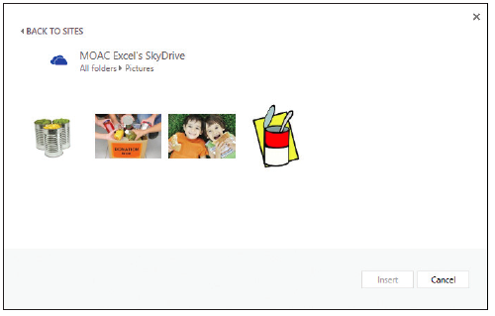
Step by Step: Insert an Image from Your SkyDrive
Double-click the Pictures folder or whichever folder contains the picture you want to insert. The folder opens, displaying the images it contains (right).
Scroll through the images, select the 13 Canned Veges image, and then click the Insert button. You can also double-click the desired image.

Slide 13
Step by Step: Insert an Image from Your SkyDrive
Once an image is inserted, the dialog box closes automatically.
SAVE the workbook as 13 Insert Pictures Solution and CLOSE the file.
PAUSE. LEAVE Excel open to use in the next exercise.

Slide 14
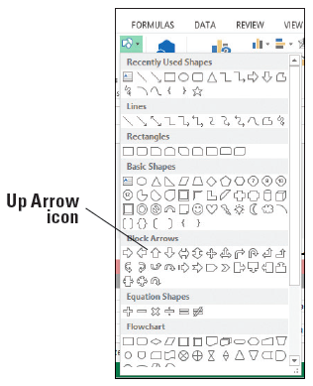
Step by Step: Add a Shape
GET READY. LAUNCH Excel if it’s not already running.
OPEN 13 Add Shapes from the data files for this lesson.
On the INSERT tab, in the Illustrations group, click the Shapes button. A menu of shape categories appears, as shown at right.

Slide 15
Step by Step: Add a Shape
Click the Up Arrow shape in the Block Arrows section. The Up Arrow shape is on the first line in the Block Arrows section, third from the left.
Move the mouse pointer onto the worksheet, just below the FUNDS RAISED column. The mouse pointer appears as a crosshair. Draw the shape by clicking and dragging down and a little to the right. The shape appears as you drag.

Slide 16
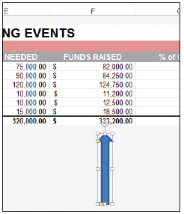
Step by Step: Add a Shape
When the shape is the desired size (both size and proportions can be changed later, so don’t worry about being perfect), release the mouse button. Your block arrow should look similar the one at right.
Click any blank cell.
SAVE the workbook.
PAUSE. Leave the workbook open to use in the next exercise.

Slide 17
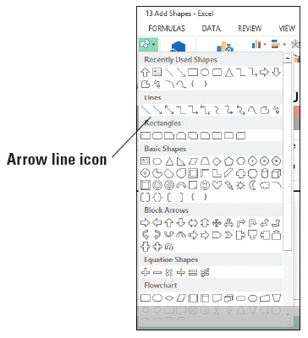
Step by Step: Draw Lines
GET READY. USE the workbook from the previous exercise.
On the INSERT tab, in the Illustrations group, click the Shapes button.
In the Lines section, click the Arrow line (right).
Move the mouse pointer onto the worksheet (it appears as a crosshair), and click over the left side of cell D22 and drag diagonally up and to the right, toward cell D19.
Notes:
Take Note: When drawing straight lines, with or without arrowheads, to constrain the line to a 45° or 90° angle, hold the Shift key as you drag to draw the line. Release the mouse button before releasing the Shift key to maintain the angle after the line is completed.

Slide 18
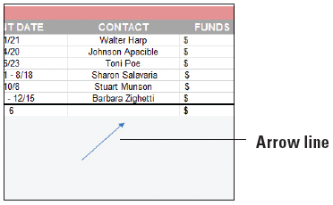
Step by Step: Draw Lines
When your line is complete, release the mouse button and click a blank cell. A finished line is shown at right.
SAVE the workbook.
PAUSE. Leave the workbook open to use in the next exercise.

Slide 19
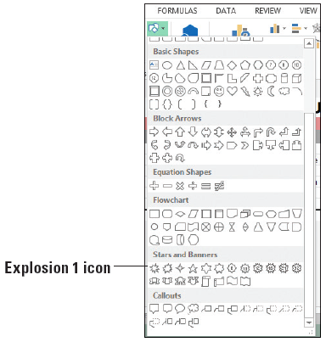
Step by Step: Add Text to a Shape
GET READY. USE the workbook from the previous exercise.
On the INSERT tab, in the Illustrations group, click the Shapes button.
In the Stars & Banners section, click the Explosion 1 shape (right).

Slide 20
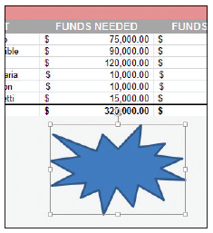
Step by Step: Add Text to a Shape
Click and drag the mouse pointer under the FUNDS NEEDED column, so the shape looks similar to the figure at right.
With the shape still selected, type Goal Exceeded!. The text begins in the upper left of the shape and wraps within the shape if the width is too small to display all text on one line. Don’t press Enter unless you want to force the text onto a new line to create a new paragraph or to place words or phrases on separate lines.

Slide 21
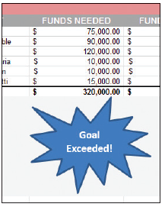
Step by Step: Add Text to a Shape
To format the text in the shape, select the text by clicking just to the left of the “G” in Goal and dragging through all text. Note that when you’re within the shape that contains text, the mouse pointer turns to an I-beam cursor.
With the text selected, use the formatting tools in the Mini Toolbar or on the HOME tab to bold and center the text, and change the font size to 14. Grab a sizing handle on either side of the shape and pull to the left, right, or down a bit until all text appears, above.
SAVE the workbook.
PAUSE. Leave the workbook open to use in the next exercise.
Notes:
Cross Reference: You learned how to format text in Lesson 6.

Slide 22
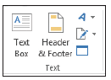
Step by Step: Add a Text Box
GET READY. USE the workbook from the previous exercise.
On the INSERT tab, in the Text group, click the Text Box button, right.
Move the mouse pointer onto the worksheet over cell B20. The mouse pointer turns into a vertical cursor.
Click and drag to cell C24 to draw a small box. If you draw a box that’s too big or too small for the text you will type into the box, you can resize the box after typing the text.

Slide 23
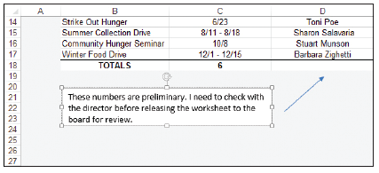
Step by Step: Add a Text Box
The text box contains a blinking cursor. Type These numbers are preliminary. I need to check with the director before releasing the worksheet to the board for review. See below.
Click in cell A1 to make the text box non-active and to prepare for the next exercise.
SAVE the workbook.
PAUSE. Leave the workbook open to use in the next exercise.
You can use the formatting tools on the HOME tab or on the Mini Toolbar to format text in a text box.

Slide 24
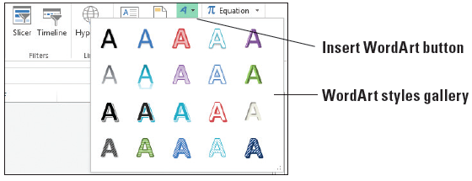
Step by Step: Use WordArt
GET READY. USE the workbook from the previous exercise.
On the INSERT tab, in the Text group, click the Insert WordArt button. The WordArt styles gallery appears, as shown below.
Select the Fill - Blue, Accent 1, Shadow style, which is on the first row, second from the left.

Slide 25
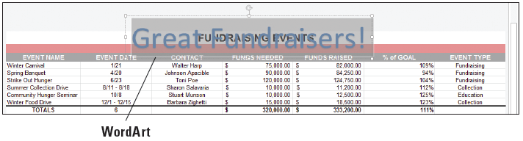
Step by Step: Use WordArt
A box of sample text appears on the worksheet. Triple-click in the box to select all sample text and type Great Fundraisers!. Notice in the figure below that the style you chose in Step 2 is applied to the sample text.
SAVE the workbook as 13 Add Shapes Solution and CLOSE the file
PAUSE. LEAVE Excel open to use in the next exercise.

Slide 26
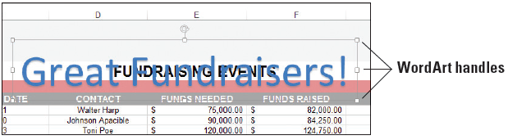
Step by Step: Delete Graphics
GET READY. LAUNCH Excel if it’s not already running.
OPEN 13 Delete Copy Move from the data files for this lesson.
On the Fundraising Events worksheet, click the WordArt graphic. Handles appear on its edges as shown below.

Slide 27
Step by Step: Delete Graphics
Press the Delete key on your keyboard. Excel deletes the graphic.
Click the block arrow graphic and press the Delete key.
SAVE the workbook.
PAUSE. Leave the workbook open to use in the next exercise.

Slide 28
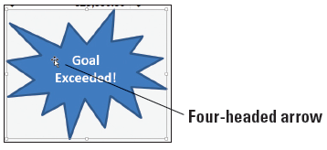
Step by Step: Move Graphics
GET READY. USE the workbook from the previous exercise.
Click the starburst shape. Handles appear on its edges.
Point the mouse pointer inside the graphic. The mouse pointer should change to a four-headed arrow, as shown below.

Slide 29
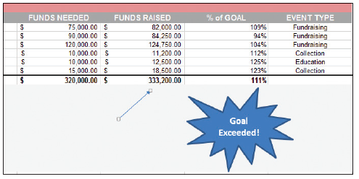
Step by Step: Move Graphics
Click and drag the graphic so it appears under the % of GOAL column. Release the mouse button.
Click and drag the arrow shape so it points to the FUNDS RAISED column, as shown below.
SAVE the workbook.
PAUSE. Leave the workbook open to use in the next exercise.
Notes:
Take Note: While the object is selected, you can move it without using the mouse. Just tap the arrow keys on your keyboard to nudge the object in small increments–up, down, left, or right.

Slide 30
Step by Step: Copy a Graphic
GET READY. USE the workbook from the previous exercise.
On the Fundraising Events worksheet, click the text box to select it.
Right-click a border of the text box and select Copy from the shortcut menu.
Click the Volunteers tab.
Right-click in cell A1 and under Paste Options in the shortcut menu, select the Use Destination Theme.
Notes:
Another Way: You can also click the object to select it and then press Ctrl + C to copy it to the Clipboard.
Another Way: You can click in the target spot and press Ctrl+V to paste the object from the Clipboard.

Slide 31
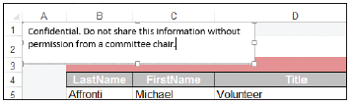
Step by Step: Copy a Graphic
Triple-click inside the text box to select all text, and then type Confidential. Do not share this information without permission from a committee chair. The text box is shown below.
SAVE the workbook as 13 Delete Copy Move Solution and CLOSE the file.
PAUSE. LEAVE Excel open to use in the next exercise.

Slide 32
Step by Step: Apply a Style to a Shape
GET READY. LAUNCH Excel if it’s not already running.
OPEN 13 Format Graphics from the data files for this lesson.
In the Fundraising Events worksheet, click the starburst shape to select it.
On the DRAWING TOOLS FORMAT tab, in the Shape Styles group, hold your mouse over each of the styles in the Shape Styles mini gallery. Excel previews each style using the selected shape.

Slide 33
Step by Step: Apply a Style to a Shape
To see the full list of styles, click the More arrow in the lower right corner of the Shape Styles mini gallery. The Shape Styles gallery appears (see Figure 13-22).
From the gallery, select Light 1 Outline, Colored Fill - Olive Green, Accent 3. This style is on the third row, fourth from the left. The style is applied to your shape.

Slide 34
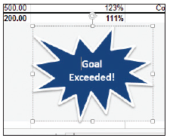
Step by Step: Apply a Style to a Shape
To change the shape’s fill color, in the Shape Styles group, click the Shape Fill button. The color palette appears.
From the first row of the palette under Theme Colors, select Dark Blue, Text 2. The object’s background color changes to dark blue (above).

Slide 35
Step by Step: Apply a Style to a Shape
SAVE the workbook.
PAUSE. Leave the workbook open to use in the next exercise.

Slide 36
Step by Step: Resize a Graphic
GET READY. USE the workbook from the previous exercise.
Select the starburst shape.
Point to the lower-left corner handle. When the mouse pointer turns to a two-headed arrow, drag inward to make the graphic smaller. With the handle still selected, drag outward to make the graphic larger. By pressing the Shift key while using a corner handle, you maintain the current width-to-height ratio when resizing a graphic.

Slide 37
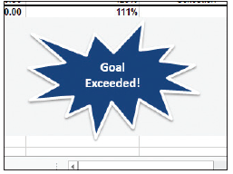
Step by Step: Resize a Graphic
To change the height of the shape, drag a top or bottom handle. This allows you to stretch the shape vertically.
To change the width of the shape, drag a side handle– drag outward to widen it and inward to make it narrower. Adjust your starburst shape so it resembles the figure above.
SAVE the workbook.
PAUSE. Leave the workbook open to use in the next exercise.

Slide 38
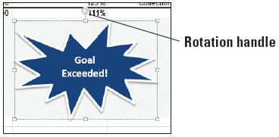
Step by Step: Rotate a Graphic
GET READY. USE the workbook from the previous exercise.
Select the starburst shape.
Point to the rotation handle (below). The mouse pointer turns to a circular arrow.
Drag the mouse counterclockwise. As you drag, the mouse pointer changes to a series of arrows in a circle.

Slide 39
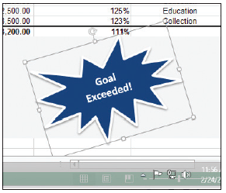
Step by Step: Rotate a Graphic
When the shape is rotated to the desired angle, similar to the figure at right, release the mouse button.
SAVE the workbook.
PAUSE. Leave the workbook open to use in the next exercise.

Slide 40
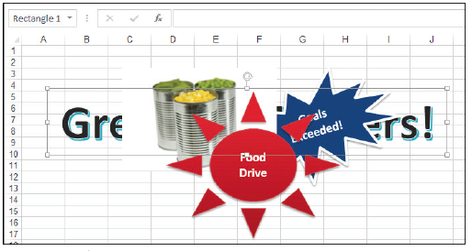
Step by Step: Control Stacking Order when Graphics Overlap
GET READY. USE the workbook from the previous exercise.
In the Format Graphics workbook, click the Overlap sheet tab. The worksheet contains several overlapping graphics.
Select the border of the WordArt graphic (Great Fundraisers), which has other graphics stacked on top of it. The figure at right shows the stack of graphics. The WordArt object, which is further down in the stack, is selected.

Slide 41

Step by Step: Control Stacking Order when Graphics Overlap
On the DRAWING TOOLS FORMAT tab, in the Arrange group, click the Bring Forward button. The WordArt graphic moves up one level in the stack.
Click the Bring Forward arrow button and select Bring to Front. The WordArt graphic appears at the top of the stack (below).

Slide 42
Step by Step: Control Stacking Order when Graphics Overlap
With the graphic still selected, click the Send Backward button to move it back one level. The Food Drive shape is now on top.
SAVE the workbook as 13 Format Graphics Solution and CLOSE the file.
PAUSE. LEAVE Excel open to use in the next exercise.
Notes:
Take Note: You can use the Bring Forward and Send Backward commands repeatedly, so that, for example, a shape can go from sixth place in a stack of six items to third. To use these buttons without having to display the drop-down menu and make a choice there, just click the Send Backward or Bring Forward buttons rather than clicking their button arrows.

Slide 43
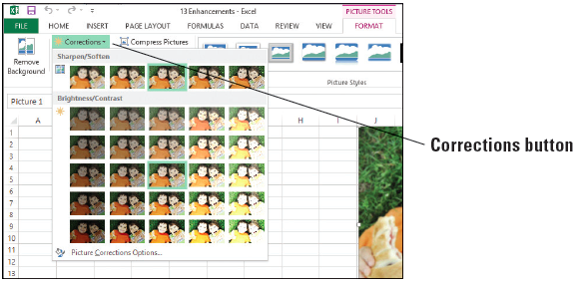
Step by Step: Make Corrections to a Graphic
GET READY. LAUNCH Excel if it’s not already running.
OPEN 13 Enhancements from the data files for this lesson.
In the Correction worksheet, select the photo of two boys.
On the PICTURE TOOLS FORMAT tab, in the Adjust group, click the Corrections button. The menu shown above appears.

Slide 44

Step by Step: Make Corrections to a Graphic
Using the thumbnails of your selected photo from the Sharpen/Soften corrections section, make a choice that represents the adjustment you’re looking for—more sharpness for a blurry picture or perhaps softening for an image that’s too sharp or where the exposure was too harsh. At the far right end of the Sharpen/Soften section, select Sharpen: 50%. The figure below shows two side-by-side images—the image on the left before applying 50% sharpening and the image on the right after.
Notes:
Take Note: Excel allows you to hover your mouse over the thumbnails that represent various corrections and see the effect in your selected photo before committing to the change. Point to any thumbnail in the Corrections menu, wait a second, and observe the change in your photo. If you like the effect, click the thumbnail. If not, move on and preview another.

Slide 45
Step by Step: Make Corrections to a Graphic
To adjust a photo that’s too dark or too light, use the Brightness/Contrast settings, also represented by thumbnails showing your selected photo in varying stages of correction. Hold your mouse over each of the settings to see their effect on your photo, but don’t select any of the settings.
SAVE the workbook.
PAUSE. Leave the workbook open to use in the next exercise.

Slide 46
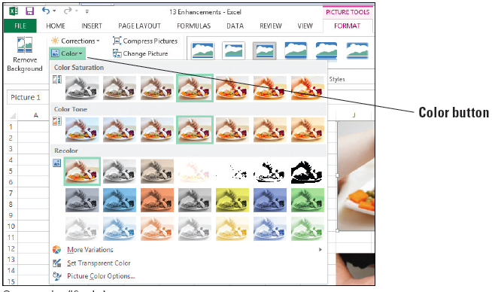
Step by Step: Change the Color of an Image
GET READY. USE the workbook from the previous exercise.
Click the Color sheet tab and select the top photo, which shows a baby holding a spoon.
On the PICTURE TOOLS FORMAT tab, in the Adjust group, click the Color button. The menu shown above appears.

Slide 47
Step by Step: Change the Color of an Image
Hold your mouse over each thumbnail of your photo to see its effect.
In the Recolor section of the Color menu, on the first line of the gallery, select Sepia. The image takes on brown tones.
On the PICTURE TOOLS FORMAT tab, in the Adjust group, click the Color button, and then select Picture Color Options at the bottom of the menu.

Slide 48
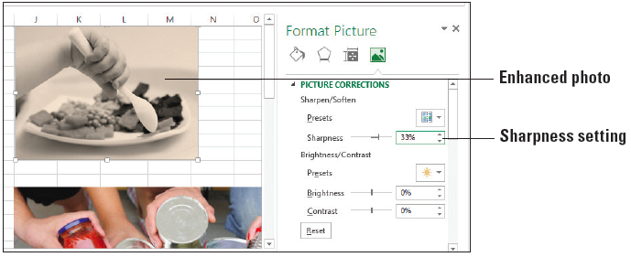
Step by Step: Change the Color of an Image
In the Format Picture pane on the right, move the Sharpness slider to the right until you reach the 33% value. Your photo should look similar to the figure below.
Close the Format Picture pane.
SAVE the workbook.
PAUSE. Leave the workbook open to use in the next exercise.

Slide 49
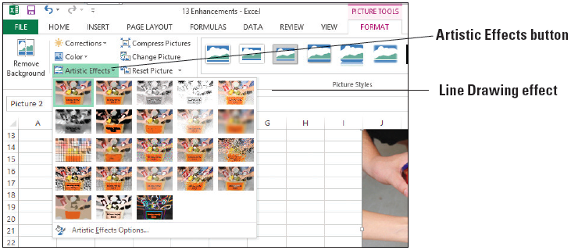
Step by Step: Apply Artistic Effects
GET READY. USE the workbook from the previous exercise.
In the Color worksheet, select the donation box photo.
On the PICTURE TOOLS FORMAT tab, in the Adjust group, click the Artistic Effects button. The gallery of effects thumbnails is shown below.

Slide 50

Step by Step: Apply Artistic Effects
Hold your mouse over each effect to see its preview on the photo. Select the Line Drawing effect. The figure below shows the Line Drawing effect applied.

Slide 51
Step by Step: Apply Artistic Effects
You can customize the applied effect using the Format Picture pane. To display the pane, open the Artistic Effects menu and select Artistic Effects Options at the bottom of the menu. In the Format Picture pane that appears on the right, move the Pencil Size slider to the right to observe its effect on the photo, stopping at the value 28. Then move the Transparency slider to the right, stopping at the value 51%.
Close the Format Picture pane.
SAVE the workbook.
PAUSE. Leave the workbook open to use in the next exercise.

Slide 52
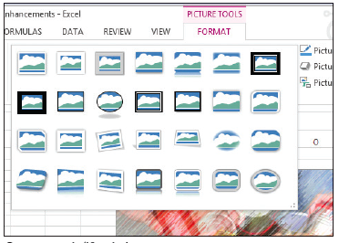
Step by Step: Apply Picture Styles
GET READY. USE the workbook from the previous exercise.
In the Color worksheet, select the donation box photo.
On the PICTURE TOOLS FORMAT tab, in the Picture Styles group, hold your mouse over each of the styles in the mini gallery to see their effect on your photo.
In the lower-right corner of the mini gallery, click the More button to display the Picture Styles gallery (above).

Slide 53
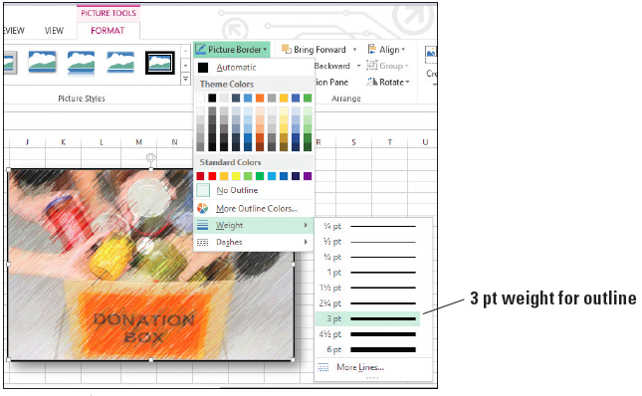
Step by Step: Apply Picture Styles
Select Drop Shadow Rectangle, which is on the first row, fourth from the left. The style is applied to your picture.
To change the picture border, click the Picture Border button, point to Weight, and select 3 pt (above).
SAVE the workbook.
PAUSE. Leave the workbook open to use in the next exercise.

Slide 54
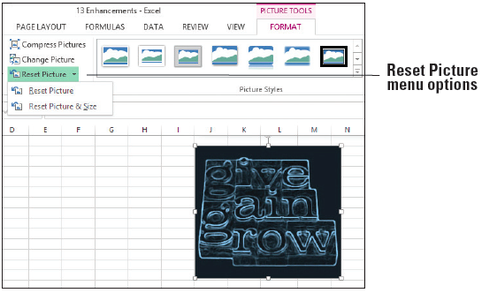
Step by Step: Reset a Picture
GET READY. USE the workbook from the previous exercise.
On the Color worksheet, scroll down and select the third photo (Give, Gain, Grow).
On the PICTURE TOOLS FORMAT tab, in the Adjust group, click the Reset Picture arrow button. Two options appear (right).

Slide 55
Step by Step: Reset a Picture
Select Reset Picture & Size to remove all changes made since insertion.
SAVE the workbook.
PAUSE. Leave the workbook open to use in the next exercise.
The Reset Picture option removes corrections, color, styles, and effects.

Slide 56
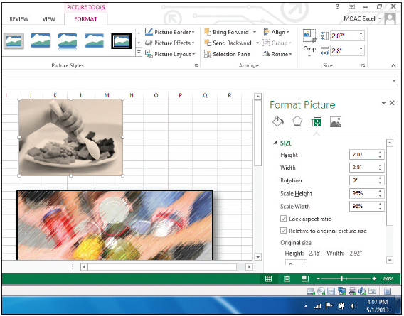
Step by Step: Modify a Picture’s Properties
GET READY. USE the workbook you modified in the previous exercise.
Click the Color sheet tab.
Right-click the baby feeding photo and select Size and Properties from the shortcut menu. The Format Picture pane appears on the right side of the workspace, as shown at right.

Slide 57
Step by Step: Modify a Picture’s Properties
Scroll down if necessary and click the PROPERTIES category.
Select the Move and size with cells option. This option associates the object with the cells it overlays.
Close the Format Picture pane.
Grab the column border between column headings J and K, and then drag to the right to widen column J. Notice that the picture becomes wider as well.

Slide 58
Step by Step: Modify a Picture’s Properties
Click the Undo icon in the Quick Access Toolbar to undo the column width setting.
SAVE the workbook as 13 Enhancements Solution and CLOSE the file.
PAUSE. LEAVE Excel open to use in the next exercise.

Slide 59
Step by Step: Capture a Screenshot
GET READY. LAUNCH Excel if it’s not already running.
OPEN 13 Screenshot from the data files for this lesson.
OPEN 13 Fundraising Flash from the data files for this lesson. This is a Microsoft Word document. You will capture a screenshot of some content in this document and insert it into an Excel worksheet. Click Enable Editing if the message appears.
On the taskbar, click the Excel icon to switch to the Excel workbook. Click in cell A1.

Slide 60
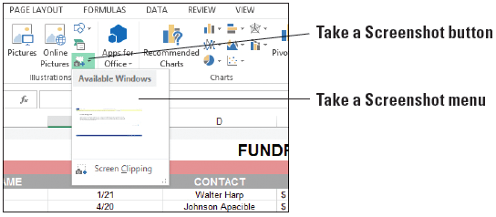
Step by Step: Capture a Screenshot
On the INSERT tab, in the Illustrations group, click the Take a Screenshot button arrow. The screenshot menu appears, as shown at right.
Your options include the windows of other applications currently open (in this case, Word), or to implement Screen Clipping, which allows you to draw a box around any space within any open application and make that the inserted graphic. Select Screen Clipping.

Slide 61
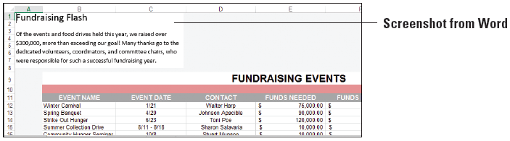
Step by Step: Capture a Screenshot
The Word document appears. Drag the mouse pointer, which looks like a crosshair, over the text and release the mouse button. The screenshot appears in the Excel document.
The figure below shows the inserted screenshot, which is a section of a Word document pertaining to the year’s fundraising events.
SAVE the workbook as 13 Screenshot Solution and CLOSE the file. CLOSE the Word program.
PAUSE. LEAVE Excel open to use in the next exercise.

Slide 62
Step by Step: Create a Flowchart
GET READY. LAUNCH Excel if it’s not already running.
OPEN 13 SmartArt from the data files for this lesson.
At the bottom of the workbook, click the New sheet icon to create a new sheet. Rename it Process and move it to the end of the row of worksheets.
On the INSERT tab, in the Illustrations group, click the Insert a SmartArt Graphic button. The Choose a SmartArt Graphic dialog box opens.

Slide 63
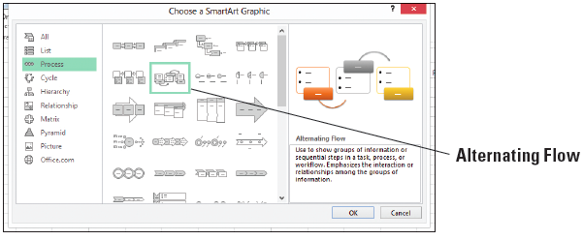
Step by Step: Create a Flowchart
The list of SmartArt categories appears on the left side of the dialog box. Click the Process category.
From the options, select the flowchart that best suits your needs for the process you want to depict. Chosen in the figure below is the Alternating Flow, which pairs a colored box with the name of a step in the process with a bulleted list of the tasks related to the process.
Click OK to begin building the flowchart.

Slide 64
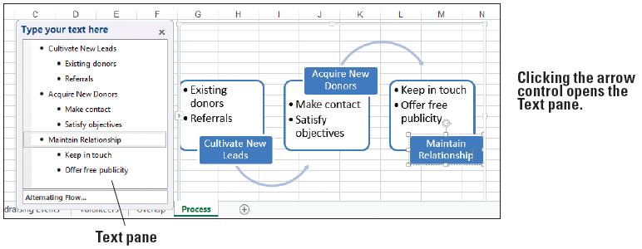
Step by Step: Create a Flowchart
On the left edge of the SmartArt graphic, click the arrow control to open the Text pane. In the Text pane, enter the names of each step in the process (the top-most bullet) and the tasks related to each one (the sub-bullets under each main bullet). Excel builds the flowchart as you type text. See the figure below for the text to be entered.
SAVE the workbook.
PAUSE. Leave the workbook open to use in the next exercise.

Slide 65
Step by Step: Create an Organization Chart
GET READY. USE the workbook from the previous exercise.
Insert a new worksheet, naming the tab Organizational Chart.
On the INSERT tab, in the Illustrations group, click the SmartArt button. The Choose a SmartArt Graphic dialog box opens.
In the list of SmartArt categories on the left side of the dialog box, click the Hierarchy category.

Slide 66
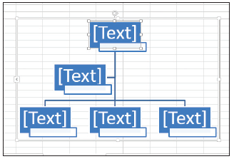
Step by Step: Create an Organization Chart
Select the Name and Title Organization Chart and click OK. The figure at right shows the chart, which pairs a colored box intended to contain the person’s name and a smaller text box for the person’s job title. The boxes are connected by lines to show relationships and structure.

Slide 67
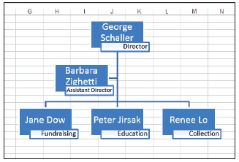
Step by Step: Create an Organization Chart
Using the Text pane, type the names of the people to be included in the chart. Enter job titles for each person by clicking the white box underneath the larger color-filled name box. Type the job title for each person, one per box. The completed chart is shown above.
SAVE the workbook as 13 SmartArt Solution and CLOSE the file.
CLOSE Excel.

Slide 68
Skill Summary

